Slide 1
Problem Solving
An Overview of Key Concepts in AI Problem Solving

Slide 2
Contents
Problem Solving
Search Algorithms
Informed Search
Uninformed search
Local search and Optimization Problems
Adversarial search and game playing
Constraints Satisfaction Problems
Representation of CSP
Search algos for CSP
Optimization Technique

Slide 3
Defining Problems as a State Space Search
- State Space: A set of all possible states
- Initial State: The starting point of the problem
- Goal State: The desired outcome to reach
- Search: Moving from the initial state to the goal state through valid transitions
Notes:
Notes:
State Space: This represents all possible configurations of the problem at hand. Imagine the problem as a collection of states, where each state represents a possible situation or condition.
Initial State: The condition from which we begin solving the problem.
Goal State: This is the solution to the problem—what we aim to reach.
State Space Search: Involves systematically moving through the state space from the initial state to the goal state. Transitions between states occur through valid actions, and solving the problem means finding a sequence of actions that leads to the goal state.
Example: In a maze-solving problem, the state space consists of all possible positions within the maze. The initial state is the starting point, and the goal state is the exit.

Slide 4
Problem Solving Agents
It is an AI agent that decides what actions to take by formulating, searching, and executing a sequence of actions that lead to the desired goal.
Characteristics:
Goal-oriented
Uses search algorithms to find solutions
Takes decisions based on knowledge of states and actions
Operates in a deterministic, fully observable, and static environment
Example: A navigation agent (Google Maps AI) setting origin and destination → computing path → following it
Notes:
Components of a Problem-Solving Agent:
Goal Formulation – What do I want to achieve?
Problem Formulation – What actions/states describe the problem?
Search – Explore possible actions to reach the goal.
Execute the Solution – Perform actions in the real world.

Slide 5
Problem Solving Processes
It includes the major steps an agent follows to reach a goal.
Step 1: Goal Formulation
Define what the agent wants to achieve.
Step 2: Problem Formulation
Translate the goal into a problem that can be solved by search.
Step 3: Search for a Solution
Use algorithms like BFS, DFS, A*, etc., to find a sequence of actions.
Step 4: Execution of Solution
Implement the actions one by one in the environment.
Step 5: Evaluation
Check if the goal is achieved; if not, re-plan.

Slide 6
Production Systems
Rule-based systems
Components: Rule set, Working memory, and Control system
Used in automated reasoning and AI systems
Notes:
Production Systems in Artificial Intelligence
Definition: Production systems are a type of rule-based system widely used in Artificial Intelligence for modeling intelligent behavior, especially in automated reasoning and decision-making processes. These systems use predefined rules to manipulate symbolic information and reach conclusions or perform actions.
Key Components of a Production System
Rule Set (Production Rules):
A collection of IF-THEN statements (also called productions).
Each rule represents a conditional action:
IF certain conditions are true in the current state,
THEN perform a specific action or update the state.
Example Rule: IF temperature > 100°F AND has_cough THEN suggest_flu_test.
Rules are written in a structured way to reflect domain knowledge.
Working Memory (Short-term Memory):
Holds the current state of the environment or system.
Includes facts, observations, or intermediate results.
Updated dynamically as rules are applied.
For example, in a medical system, working memory might include symptoms like "fever" and "headache".
Control System (Inference Engine):
Manages the application of rules:
Selects which rule to apply when multiple rules are applicable.
Determines the order of execution (conflict resolution).
Handles looping, backtracking, and termination conditions.
Common strategies:
Forward chaining (data-driven)
Backward chaining (goal-driven)
How It Works
The system starts with a set of known facts in working memory.
It checks which rules’ conditions match the current facts.
One or more matching rules are selected (based on a strategy).
The selected rule is applied, updating the working memory.
Steps 2–4 repeat until a goal is reached or no further rules apply.
Applications of Production Systems
Expert Systems: Simulate decision-making of a human expert.
E.g., MYCIN (medical diagnosis), CLIPS (NASA system)
Robotics and Control Systems
Game AI: Decision-making in games like chess or simulations.
Natural Language Processing: Rule-based grammar parsers.
Diagnostic Systems: Fault detection in machinery or software.
Example: Medical Diagnosis System
Let’s consider a simplified example:
Working Memory (Facts):
Symptom: fever
Symptom: cough
Symptom: fatigue
Rule Set:
IF fever AND cough THEN suspect_flu
IF fatigue AND suspect_flu THEN suggest_test_for_influenza
Inference:
The system detects fever and cough → applies Rule 1 → adds suspect_flu to working memory.
Now, fatigue and suspect_flu are both present → applies Rule 2 → suggests a flu test.
Types of Production Systems:
Monotonic – facts never change
Non-monotonic – facts can be changed/deleted
Deterministic – rules produce predictable outcomes
Non-deterministic – outcomes vary
Advantages of Production Systems
Easy to modify or extend the knowledge base.
Transparent logic: reasoning steps can be traced.
Well-suited for complex decision-making tasks with clear rules.
Limitations
Can become inefficient if the rule set grows too large.
Lacks learning ability unless integrated with other AI techniques.
Needs complete and correct rules to function reliably.

Slide 7
Introduction to Rule-Based Systems
Systems that use logical 'IF-THEN' rules to process knowledge and make decisions.
Simulate expert decision-making processes.
Examples: Medical diagnosis systems, Fault detection systems, Recommendation engines.

Slide 8
Key Components of Rule-Based Systems
Rule Set: Collection of logical 'IF-THEN' statements.
Working Memory: Dynamic storage of facts related to the problem.
Control System: Manages the selection, application, and sequencing of rules.
Notes:
Applications of Rule-Based Systems
Automated Reasoning: Derive conclusions automatically.
Expert Systems: Emulate decision-making of human experts.
AI Systems: Transparency-focused applications.
Examples: MYCIN (medical diagnosis), DENDRAL (chemical analysis).
Example scenario:
Medical Diagnosis: IF high fever AND sore throat THEN suggest COVID-19 test.
Loan Approval: IF credit score >750 AND income >$50,000 THEN approve loan.
Engine Fault Detection: IF oil pressure low AND engine temperature high THEN alert overheating risk.
Advantages:
Transparency: Easily understandable decision process.
Ease of Modification: Simple rule addition/removal.
Simplicity: Straightforward design and operation.
Effective for Well-Defined Problems: Works well where knowledge is explicit.
Limitations:
Scalability Issues: Complexity increases with more rules.
Conflict Management: Hard to resolve when multiple rules trigger.
Lack of Learning: Does not adapt to new situations automatically.
Maintenance Challenges: Requires careful updates to avoid inconsistencies.
Conclusion Summary: Rule-based systems are foundational in AI, offering transparency and logical decision-making.
Current Use: Remain important in fields requiring explainability.
Future: Integration with machine learning for hybrid, explainable AI systems.

Slide 9
Well-Defined Problems
- A problem with clear states, actions, and goals
- Fully observable environment
- Definite goal test and measurable cost of actions
Example 8 puzzle game
Notes:
Well-defined Problems have:
Clear States: You know exactly where you are in the problem space at any given time.
Observable Environment: You have full information about the problem, and there are no hidden factors.
Definite Goal Test: There is a clear way to verify when you have reached the goal.
Measurable Costs: You can quantify the cost or value of taking a specific action or transition between states.
Example: Solving a math problem is well-defined—every step is known, the goal is clear (the answer), and there’s a cost (e.g., time taken or complexity).
States: Each arrangement of the 3x3 grid consisting of tiles numbered 1 through 8 and a blank space.
Initial State: A specific tile layout at the start.
Goal State: Arrangements with blank space in the lower-right corner and the tiles arranged in numerical order.
Actions: Up, down, left or right movement of the empty space.
Transition Model: Describes the state generated after performing an action.
Path Cost: Cost of each move is uniform and equals one.
Ill-Defined Problems
These lack formal structure. Goals, states, and actions are unclear or vague.
✔ Characteristics:
Incomplete or vague goals
Unclear initial state
No defined operators
No evaluation function
✔ Examples:
Writing an essay
Designing a building
Planning a wedding
Creativity-based tasks
✔ Why difficult?
AI cannot apply standard search; requires reasoning, knowledge, creativity

Slide 10
Problem Formulation and Problem Types
Deciding what actions and states to consider.
Initial state | Actions | Transition model | Goal | Path cost
Types:
1. Deterministic vs Stochastic Problems
2. Single-agent vs Multi-agent Problems
3. Static vs Dynamic Problems
Notes:
Notes:
Problem Formulation: A critical step where we explicitly define:
States: Different configurations or situations.
Actions: Moves or operations that can be performed.
Goal: The end condition we aim for.
Problem Types:
Deterministic: The result of an action is predictable (e.g., Chess).
Stochastic: Outcomes involve randomness (e.g., Poker).
Single-agent: One agent attempts to achieve a goal (e.g., a puzzle-solving robot).
Multi-agent: Multiple agents, often competing or cooperating (e.g., multiplayer games).
Static: The environment doesn't change while the problem is being solved.
Dynamic: The environment evolves or changes (e.g., traffic flow).
Example: In Chess (deterministic, multi-agent, static), a player can predict the outcome of their move, knowing that the opponent will respond with another move.

Slide 11
Puzzle problem
Given a 3×3 board with 8 tiles (each numbered from 1 to 8) and one empty space, the objective is to place the numbers to match the final configuration using the empty space. We can slide four adjacent tiles (left, right, above, and below) into the empty space
Question: How can we move number such that we can get empty box at last?
States, initial state, goal state, production rules

Slide 12
Missionaries and cannibal
3 missionaries and 3 cannibals on one side of river, all are to be moved to another side of river via boat, boat can take only two passengers. The condition is that the no. of cannibals should not exceed then no. of missionaries in either of the banks. If exceeded the missionaries will be eaten.
Question : How can the boat be used to carry all missionaries and cannibals to another bank safely?
States, Initial state, Goal state, Production rules

Slide 13
Water Jug problem
You have two jugs, one of 4 liters and another of 3 liters. There is no any measurement level on either of jugs, now your objective is to get 2 liters of water in 4liter jug. You can get any amount of water from tap and can drop any amount of water in ground.
Question: What are state representations.
States, initial state, goal state, and production rules.

Slide 14
Searching
Uninformed Search
Depth First Search (DFS)
Breadth First Search (BFS)
Depth limit search
Informed search
Greedy Search
Best first search
A* Search
Hill Climbing
Simulated Annealing
Genetic Algorithm
Adversarial search techniques
Min-Max Procedure
Alpha beta procedure
Iterative Deepening Search
Notes:
Here, the algorithms have information on the goal state, which helps in more efficient searching. This information is obtained by something called a heuristic.
The uninformed search algorithms in this section have no additional information on the goal node other than the one provided in the problem definition
E.g. : Maze
Uninformed search is also called Blind search
These algorithms can only generate the successors and differentiate between the goal state and non goal state
A problem graph, containing the start node S and the goal node G.
A strategy, describing the manner in which the graph will be traversed to get to G.
A fringe, which is a data structure used to store all the possible states (nodes) that you can go from the current states.
A tree, that results while traversing to the goal node.
A solution plan, which the sequence of nodes from S to G.

Slide 15
Uninformed Search
Breadth-First Search
Depth First Search
Iterative Deepening Search
Depth Limit Search

Slide 16
Breadth-First Search
Looks for the goal node among all the nodes at a given level before using the children of those nodes to Expand shallowest unexpanded node fringe is implemented as a FIFO queue.
Initialization:
Start by marking the initial node as visited and adding it to a queue .
Processing Nodes:
While the queue is not empty:
Dequeue a node from the front of the queue.
Process the node (e.g., print it, store it).
Check its neighbors using the adjacency list. For each unvisited neighbor:
Mark it as visited.
Enqueue it .
Completion:
The algorithm continues until all nodes have been visited, resulting in a complete traversal of the graph .
Notes:
Graph
Undirected Graph
representation: Adjacency List
BFS is an algorithm for traversing or searching through a graph. It explores all immediate neighbors of a node before moving on to their neighbors, ensuring that the closest nodes are visited first
Key Points
BFS uses a queue to keep track of nodes to visit next and a set to track visited nodes, preventing cycles and redundant visits
The order of visitation is determined by the proximity of nodes to the starting point, ensuring that nodes closer to the start are processed first

Slide 17
BFS Algorithm
Start
Point out the pointer to root node
Mark node as visited
Print root node in output sequence
Search pointer and check for its adjacent nodes
If (adjacent == not_ visited)
Enqueue node into the queue
Mark it as visited node
Goto step 3
Else
Update the pointer to the top of the queue
Dequeue top of the queue
Print node in output sequence
Check for empty queue and pointer node has visited adjacent node
If (Queue == Empty) && pointer == visited))
Goto 5
Else
Goto 4
Stop

Slide 18
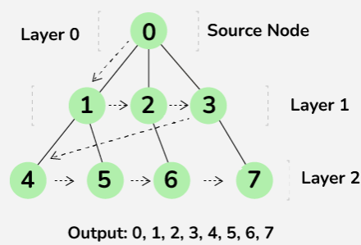
Completeness:
Does it always find a solution if one exists?
YES
If the shallowest goal node is at some finite depth d and If b is finite

Slide 19
Depth-First Search
Looks for the goal node among all the children of the current node before using the sibling of this node
Expand deepest unexpanded node
Working Logic
Select the start node.
Visit the start node.
Explore the neighbors of the start node.
If there are undiscovered neighbor nodes, switch to that node and repeat the steps (recursively or using a chunk data structure).
When there are no undiscovered neighbor nodes, go back and return to the previous node.
Repeat the steps until all nodes have been visited.
Notes:
Graph
Undirected Graph
representation: Adjancency List
BFS is an algorithm for traversing or searching through a graph. It explores all immediate neighbors of a node before moving on to their neighbors, ensuring that the closest nodes are visited first
Key Points
BFS uses a queue to keep track of nodes to visit next and a set to track visited nodes, preventing cycles and redundant visits
The order of visitation is determined by the proximity of nodes to the starting point, ensuring that nodes closer to the start are processed first

Slide 20
DFS Algorithms
Start
Push root node to stack
Mark root node as visited
Print root node in output sequence
Check top stack
If stack == empty go to stem 6
Check adjacent of top stack
If (adjacent == not visited)
Push node to the top of the stack
Mark node as visited
Printed node in output sequence
Else
pop top stack
Go to step 3
stop

Slide 21
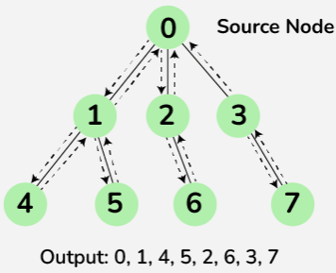
Completeness;
Does it always find a solution if one exists?
NO
If search space is infinite and search space contains loops then DFS may not find solution.

Slide 22
Depth Limited Search (DLS)
Working Logic
Algorithm will only explore nodes up to a certain depth
It is DF-search with depth limit l.
i.e. nodes at depth l is assumed to have no successors.
Problem knowledge can be used to guess the value of l Solves the infinite-path problem of DFS. Yet it introduces another source of problem if we are unable to find good guess of l. Let d is the depth of shallowest solution.
If l < d then incompleteness results.
If l > d then not optimal.
Notes:
Graph
Undirected Graph
representation: Adjancency List
BFS is an algorithm for traversing or searching through a graph. It explores all immediate neighbors of a node before moving on to their neighbors, ensuring that the closest nodes are visited first
Key Points
BFS uses a queue to keep track of nodes to visit next and a set to track visited nodes, preventing cycles and redundant visits
The order of visitation is determined by the proximity of nodes to the starting point, ensuring that nodes closer to the start are processed first

Slide 23
How Depth Limited Search Works?
Initialization: Begin at the root node with a specified depth limit.
Exploration: Traverse the tree or graph, exploring each node's children.
Depth Check: If the current depth exceeds the set limit, stop exploring that path and backtrack.
Goal Check: If the goal node is found within the depth limit, the search is successful.
Backtracking: If the search reaches the depth limit or a leaf node without finding the goal, backtrack and explore other branches.

Slide 24
Iterative deepening search
A general strategy to find best depth limit l.
Goals is found at depth d, the depth of the shallowest goal-node.
Often used in combination with DF-search
Combines benefits of DFS and BFS
It does this by gradually increasing the limit, first 0, then 1, then 2, and so on until the goal is found. This will occur when depth d is reached: that is depth of shallowest goal node.

Slide 25
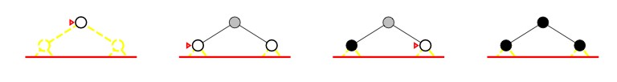
Limit 0
Limit 1

Slide 26
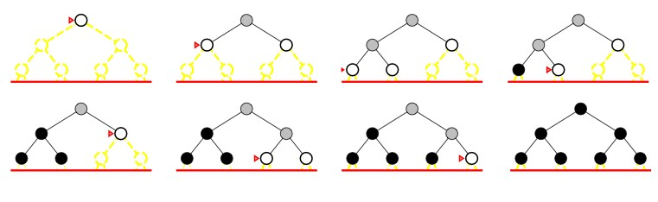
Limit 2

Slide 27
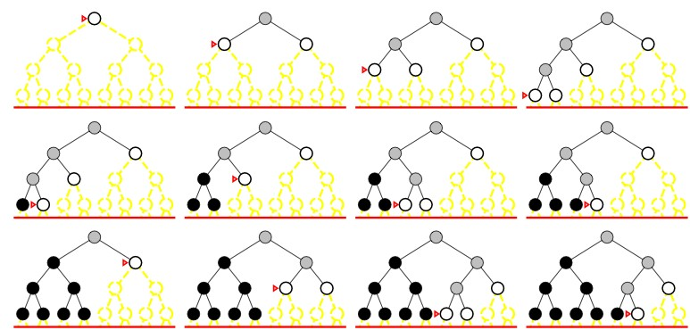
Limit 3

Slide 28
Comparison table
Criteria | Breadth-First Search (BFS) | Depth-First Search (DFS) | Depth-Limited Search (DLS) | Uniform Cost Search (UCS) | Iterative Deepening Search (IDS)
Strategy | Expand shallowest node first | Expand deepest node first | DFS with a depth limit | Expand least-cost node first | Repeated DLS with increasing limits
Data Structure | Queue (FIFO) | Stack (LIFO) | Stack with depth check | Priority Queue | Stack (repeated)
Completeness | ✔ Yes | ✘ No (fails in infinite trees) | ✔ If limit ≥ goal depth | ✔ Yes | ✔ Yes
Optimality | ✔ Yes (if uniform cost) | ✘ No | ✘ No | ✔ Yes | ✔ Yes (if step cost = 1)
Time Complexity | O(b^d) | O(b^m) | O(b^l) | O(b^d) | O(b^d)
Space Complexity | O(b^d) | O(bm) | O(bl) | O(b^d) | O(bd)
Avoids Repeated States | Only if implemented carefully | No | No | Yes (with closed list) | Yes (effectively in final iteration)
Use Case | Shortest path problems | Large trees with solutions at deep levels | Bounded depth trees | Cost-sensitive paths | Optimal search with depth sensitivity
Limitations | Memory intensive | May go deep into irrelevant paths | Requires setting a good limit | Memory & performance cost | Recomputes shallow nodes repeatedly

Slide 29
Example BFS
6
3
8
7
5
2
4
1

Slide 30
Informed Search
Greedy Best Search
A* Search
Notes:
It is a search algorithm used to find the shortest path between an initial and a final point. It is often used for map traversal to find the shortest path. A* was initially designed as a graph traversal problem to help build a robot that can find its own course

Slide 31
Greedy Best-First Search
A search algorithm that expands the node estimated to be closest to the goal based on a heuristic function.
Effective for problems with good heuristic functions.
Faster than exhaustive search methods like BFS and DFS.
CON:
Quickly finds a path to the goal but doe not guarantee the shortest path or goal (doesn’t backtrack).
Non optimal (does not gives best solution)
(Incomplete) Goal might be not found if loop is present or no path ahead.
Applications:
Robotics
Game development
Network routing
Puzzle solving in AI

Slide 32

Algorithm
Initialize:
Open list (nodes to be evaluated).
Closed list (evaluated nodes).
Start from the initial node.
calculate ℎ(𝑛) for the start node.
Iterate:
Pick the node with the lowest h(n) in the open list.
Move it to the closed list.
Evaluate neighbors:
Calculate h(n).
Add neighbors to the open list if not already present.
Goal Test:
Stop when the target node is reached.

Slide 33
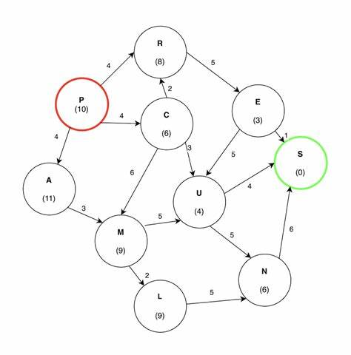
Greedy Best-First Search
Notes:
Both directed and undirected

Slide 34
A* Algorithm
A* is a popular pathfinding and graph traversal algorithm known for its efficiency and accuracy.
Finds the shortest path from a start node to a target node
Applications:
Robotics: Navigation for autonomous robots
Game development: NPC pathfinding in video games.
Network routing: GPS routing
Puzzle solving: 8-puzzle or 15-puzzle problems

Slide 35
Core Concept
f(n) = g(n) + h(n)
Total estimated cost of the path through n
Heuristic estimate of the cost to reach the goal from n
Cost to reach node n from the start.
What we will do is Expand node with lowest f(n)

Slide 36
Algorithm
Initialize lists:
Open ← {start}
Closed ← ∅
Initialize start node:
g(start) ← 0
h(start) ← heuristic(start, goal)
f(start) ← g(start) + h(start)
parent(start) ← null
Loop: while Open is not empty, do:
Select current:
current ← node in Open with lowest f(n) (break ties by lower h or other rule)
Goal test:
If current == goal → go to step 11
Move current:
Remove current from Open
Add current to Closed
For each neighbor of current: do:
Skip if closed:
If neighbor ∈ Closed → continue
Compute tentative cost:
tentative_g ← g(current) + cost(current, neighbor)
If neighbor not in Open:
Add neighbor to Open
update_needed ← true Else if tentative_g < g(neighbor):
update_needed ← true Else:
update_needed ← false
If update_needed (neighbor improved):
parent(neighbor) ← current
g(neighbor) ← tentative_g
h(neighbor) ← heuristic(neighbor, goal)
f(neighbor) ← g(neighbor) + h(neighbor)
Repeat loop (back to step 3).
If goal found (from step 5): Reconstruct path:
path ← []
node ← goal
while node ≠ null: prepend node to path; node ← parent(node)
return path
If Open becomes empty and goal not found:
return “failure” (no path exists)
Notes:
1. Initialization
Data Structures
Open List: Contains nodes that have been discovered but not yet evaluated. (Often implemented as a priority queue sorted by f(n))
Closed List: Contains nodes that have already been fully evaluated.
Start Node Setup
Begin with the initial (start) node.
Set:
g(n) = 0 → actual cost from the start to node n.
h(n) → heuristic estimate of the cost from node n to the goal.
f(n) = g(n) + h(n) → total estimated cost.
Insert the start node into the open list.
2. Iteration Loop
Repeat until the open list becomes empty:
Step A: Select Node
Pick the node from the open list that has the lowest f(n) value.
Call this node current.
Move current to the closed list.
3. Evaluate Neighbors of Current Node
For each neighbor:
If neighbor is in closed list → skip (Already evaluated)
Compute:
Tentative g-value: g_temp = g(current) + cost(current, neighbor)
Compute h(neighbor)
Compute f(neighbor) = g_temp + h(neighbor)
If neighbor is not in open list:
Add it to open list.
Store:
g(neighbor) = g_temp
Parent(neighbor) = current
If neighbor is in open list but new g-value is smaller:
Update g(neighbor) = g_temp
Recalculate f(neighbor)
Update parent pointer
4. Goal Test
If the current node is the goal, stop the algorithm.
The optimal path has been found.
5. Path Reconstruction
Start from the goal node.
Follow the parent pointers backwards:
goal → parent → parent → ... → start
Reverse this sequence to obtain the final optimal path.

Slide 37
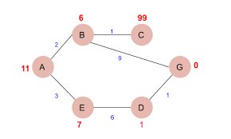

Slide 38
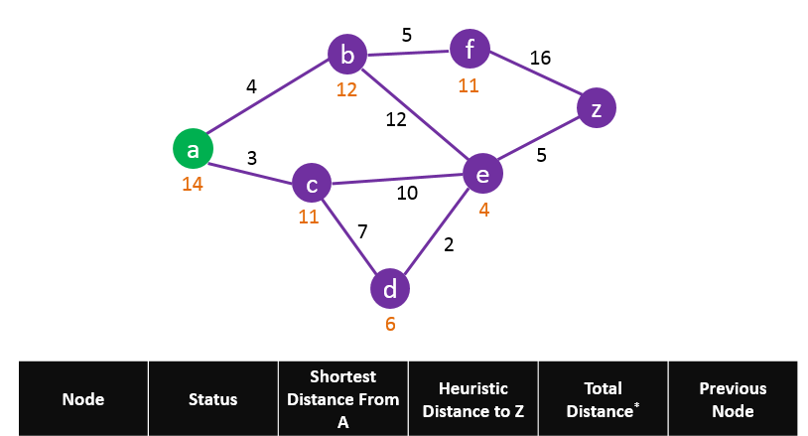
A | C | V | 0 | 0 | 0
B |  | inf
C
D
E
F
Z

Slide 39
Local Search and Optimization Problems
Local search algorithms operate by moving from one solution to a neighboring solution, aiming to improve the solution quality.
Focus on a single current state rather than exploring multiple paths.
Effective for optimization problems.
Applications:
Scheduling
Vehicle routing
Resource allocation

Slide 40
Characteristics of Local Search
State Representation:
A solution or configuration in the problem space.
Neighborhood:
A set of 'neighboring' solutions that can be reached by a small change.
Evaluation Function:
Measures the quality of a solution.

Slide 41
Hill-Climbing Search
A local search algorithm that continuously moves to the neighbor with the highest evaluation value.
Steps:
1. Start with an initial solution.
2. Evaluate neighbors.
3. Move to the best neighbor.
4. Stop if no better neighbors exist.
Notes:
Hill climbing is a local search technique that iteratively improves a candidate solution by moving to neighboring states with better objective values. "Simple" (also called first-choice or greedy) hill climbing and "steepest-ascent" hill climbing differ in how they select the next neighbor.
Key differences
Neighbor selection rule
→Simple hill climbing: Examine neighbors sequentially (in some order) and accept the first neighbor that improves the current state. Stop searching neighbors once an improvement is found.
→Steepest-ascent hill climbing: Evaluate all neighbors and choose the one with the largest improvement (best objective value) before moving.
Computational cost per step
→Simple: Low — may evaluate only a small subset of neighbors until an improving one is found.
→Steepest: Higher — must evaluate all neighbors each iteration.
Quality of moves
→Simple: May make smaller or suboptimal improvements because it stops at the first improving neighbor.
→Steepest: Chooses the largest immediate improvement, often producing larger, more directed steps.
Convergence behavior
→Simple: Typically faster per iteration and can escape some plateaus if an early neighbor improves, but more prone to getting stuck in different local optima depending on neighbor ordering.
→Steepest: More consistent and less sensitive to neighbor ordering; can reach better local maxima but still can get trapped in local optima and plateaus.
Sensitivity to neighbor ordering
→Simple: Highly sensitive—ordering can change final solution and runtime.
→Steepest: Ordering-insensitive (ties aside), deterministic given the neighborhood.
Use cases and trade-offs
→Simple: When neighborhood size is large or evaluations are expensive, or when a fast approximate improvement is sufficient.
→Steepest: When solution quality per move matters and full neighborhood evaluation is affordable; useful when fewer but more informed moves are desired.
Practical notes
Both are greedy and may require random restarts, simulated annealing, or tabu search to escape local optima.
Hybrid strategies exist: sample a subset of neighbors (stochastic hill climbing) to balance cost and quality.
In discrete problems with small neighborhoods, steepest-ascent often gives better results; in high-dimensional or expensive-evaluation problems, simple or stochastic variants are preferred.

Slide 42
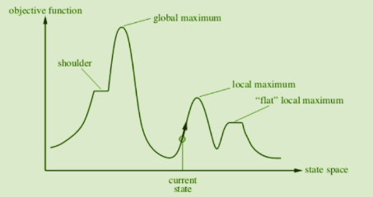
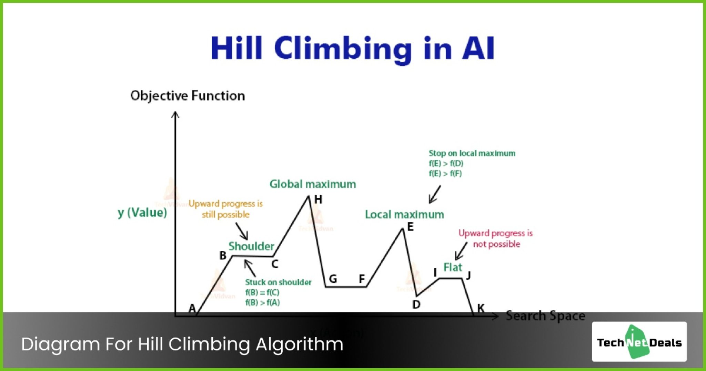

Slide 43
Problems with Hill-Climbing
Local Maxima:
A peak lower than the global maximum.
You cannot go higher even though the global peak exists elsewhere.
Back tracking can be solution
Plateaus:
A large flat area where all neighbors have the same value.
The algorithm keeps wandering without progress..
Take big steps can be solution
Ridges:
Narrow regions of high-value states that are difficult to climb
A region where direction of steepest ascent does not lead directly upward, you must go sideways first.
Using bidirectional search can help

Slide 44
Types of Hill Climbing
Simple Hill Climbing
Examines neighbors one by one.
Chooses the first better state.
Not guaranteed to find the best among neighbors.
Steepest-Ascent Hill Climbing
Looks at all neighbors.
Chooses the one with the highest improvement.
Better but more expensive.
Stochastic Hill Climbing
Randomly selects a neighbor.
Useful in large or noisy search spaces.

Slide 46
Simulated Annealing
An optimization algorithm inspired by the annealing process in metallurgy.
Key Idea:
Occasionally accept worse solutions to escape local maxima and explore the search space.
Algorithm Steps:
1. Start with an initial solution and temperature (T).
2. Generate a neighbor solution.
3. Accept the neighbor with probability: P = e^(-ΔE / T).
4. Gradually decrease T.
5. Stop when T is low or a satisfactory solution is found.

Slide 47
Simulated Annealing Process
Initialize Temperature:
Start with a high temperature to allow exploration of the solution space.
Generate a Neighbor Solution:
Make a small change to the current solution to explore nearby options.
Evaluate Solution:
If it improves the objective function, accept it as the new solution.
If it worsens the objective function, accept it with a probability based on the temperature.
Cool Down:
Gradually lower the temperature, reducing the probability of accepting worse solutions.
Repeat
until a stopping criterion (like a low temperature or a stable solution) is met.

Slide 48
Acceptance Probability and Temperature Schedule
Acceptance Probability:
P(ΔE)=exp⁡(−ΔE/T)P(\Delta E) = \exp(-\Delta E / T)P(ΔE)=exp(−ΔE/T)
Where ΔE\Delta EΔE is the change in the objective function and TTT is the temperature.
Cooling Schedule:
Linear cooling: T=T−α
Exponential cooling: T=T×α
Other custom schedules to control the rate of cooling.

Slide 49
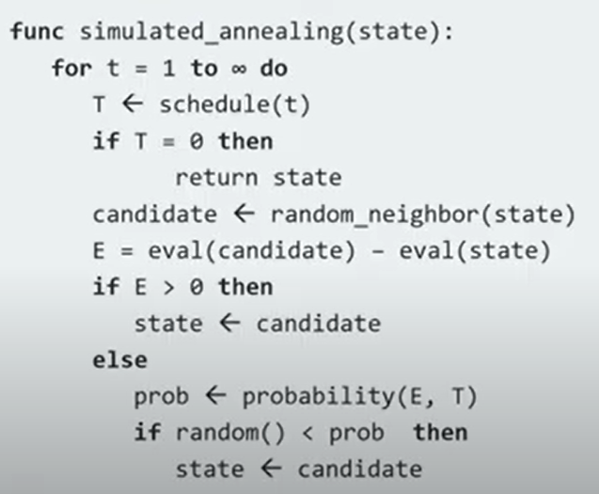

Slide 50
Genetic Algorithms
A population-based optimization algorithm inspired by natural selection.
Key Concepts:
Population: A set of candidate solutions.
Selection: Choose solutions based on fitness.
Crossover: Combine solutions to create new ones.
Mutation: Randomly modify solutions to introduce diversity.

Slide 51
Gradient Descent
An optimization algorithm used to minimize a function by iteratively moving in the direction of the steepest descent of the gradient.
Steps of Gradient Descent Algorithm
Initialize parameters (weights, bias) randomly
Compute predictions using current parameters
Calculate loss (error)
Compute gradients (partial derivatives)
Update parameters
Repeat until convergence (minimum error)
Notes:
Gradient Descent in Machine Learning
Gradient Descent is an optimization algoMrithm used to minimize a loss (cost) function in machine learning models. It helps the model find the best parameters (weights and bias) by iteratively moving in the direction of minimum error.
Think of standing on a mountain and trying to reach the lowest point (valley):
You look at the slope (gradient) around you
Take a small step downhill
Repeat until you reach the bottom
That downhill movement is gradient descent.

Slide 52
Gradient Descent
Gradient Descent is used in:
Linear & Logistic Regression
Neural Networks
Support Vector Machines
Deep Learning models
Notes:
1. Gradient Descent in Linear Regression
Purpose
To find the best-fit line by minimizing the Mean Squared Error (MSE).
Model
$$y=wx+b$$
Cost Function
Role of Gradient Descent
Computes gradients with respect to w and b
Updates parameters iteratively:
$$w=w−α\frac{∂J}{∂w}$$
Why Needed?
Closed-form solution becomes expensive for large datasets
Gradient descent is faster and scalable
✔ Used in large-scale linear regression problems
2. Gradient Descent in Logistic Regression
Purpose
To learn parameters for binary or multi-class classification.
Model
$$y=σ\left(wx+b\right)$$
Role of Gradient Descent
Minimizes cross-entropy loss
Adjusts weights so predicted probabilities match actual labels
Why Gradient Descent?
Loss function is non-linear
No direct mathematical solution
✔ Essential for classification problems
3. Gradient Descent in Neural Networks
Purpose
To train networks with multiple layers and millions of parameters
Components
Weights
Biases
Activation functions
Role of Gradient Descent
Uses Backpropagation to compute gradients
Updates parameters layer by layer
$$w=w−α\frac{∂Loss}{∂w}$$
Why Critical?
Neural networks cannot be trained without gradient descent
Enables learning of complex patterns
✔ Backbone of AI learning process
4. Gradient Descent in Support Vector Machines (SVM)
Purpose
To find the optimal separating hyperplane
Loss Function
Hinge loss
Role of Gradient Descent
Minimizes hinge loss
Used especially in:
Large-scale SVM
Soft-margin SVM
Why Gradient Descent?
Quadratic programming is expensive for big datasets
Gradient-based methods are faster
✔ Used in practical, large-data SVMs
5. Gradient Descent in Deep Learning Models
Examples
CNN (Image recognition)
RNN (Speech, text)
Transformers
Role
Optimizes millions to billions of parameters
Uses advanced variants:
SGD
Adam
RMSProp
Why Gradient Descent is Essential?
Deep models have high-dimensional loss surfaces
Only iterative optimization is feasible
✔ Makes modern AI systems possibl

Slide 53
Hill-Climbing is fast but limited by local traps.
Simulated Annealing uses randomness to escape traps.
Genetic Algorithms mimic evolution to explore the search space.
Gradient Descent is ideal for optimization in continuous spaces.

Slide 54
Adversarial Search and Game Playing
Search in competitive settings where entities have opposing goals.
Key Characteristics:
Competitive
Perfect/Imperfect Information
Deterministic/Stochastic.
Importance:
Understanding strategies, broader applications, and foundation for AI.
Notes:
Definition: Adversarial search deals with situations where two or more entities (players) compete, each aiming to maximize their own outcomes while minimizing the opponent's. This contrasts with other types of searches (like pathfinding) that focus on achieving a single objective.
How it Works:
Each player alternates turns.
Decisions are made considering not just immediate gains but also potential future consequences.
Outcomes depend on both players’ decisions.
Examples of Adversarial Search
Chess:
Two players, alternating turns, aim to checkmate the opponent’s king.
Tic-Tac-Toe:
Simple two-player game where the goal is to align three markers in a row.
Go:
Players take turns placing stones on a grid, aiming to control more territory than the opponent.
Card Games :
Incorporates imperfect information, adding complexity.

Slide 55

Game Playing
- Multi-agent environments
- Adversarial search (Minimax, Alpha-Beta pruning)
- Perfect Information games (e.g., Chess) vs Imperfect Information games (e.g., Poker)
Notes:
Notes:
Multi-agent Environments: These involve two or more agents, often in competition (e.g., a player versus an opponent in chess).
Adversarial Search: Involves strategies where agents oppose each other. Algorithms like Minimax and Alpha-Beta pruning are used in perfect-information games to anticipate an opponent's moves and counter them.
Perfect Information Games: Games where all players know the entire state of the game (e.g., Chess, Tic-Tac-Toe).
Imperfect Information Games: Games where some information is hidden (e.g., Poker).
Example: In Chess, players take turns, and each player has full visibility of the board, making it a perfect-information game. Poker, on the other hand, is imperfect information since some cards are hidden.

Slide 56
Various elements of game playing
Game can be formally defined as a kind of search problem with the following elements
S0: the initial state; specifies how game is set up at start
Players (s): defines which player has move in the state
Actions (a): returns set of legal moves in the state
Result ( s, a) : the transition model that determines result of the move
Terminal Test: True when game over .
Terminal states: States where game ends.
Utility ( s, p): numeric value at last state s for player p.

Slide 57
Min Max Algorithm
Objective:
Choose optimal moves assuming opponent plays optimally.
Steps:
Explore game states, assign utilities, and propagate values.
Example:
Game tree for Tic-Tac-Toe.

Slide 58
Pseudo code
Working mechanism
def minimax(node, depth, isMaximizingPlayer):
if depth == 0 or is_terminal(node):
return evaluate(node)
if isMaximizingPlayer:
bestValue = -infinity
for child in node.children:
val = minimax(child, depth-1, False)
bestValue = max(bestValue, val)
return bestValue
else:
bestValue = infinity
for child in node.children:
val = minimax(child, depth-1, True)
bestValue = min(bestValue, val)
return bestValue
Step 1
Game Tree Construction
Step 2
Terminal State Evaluation
Step 3
Backpropagation of Values
Step 4
Depth-based Exploration
Step 5
Optimal Move Selection
Step 6
Alpha Beta Pruning

Slide 59
Example
MAX
MIN
MAX
5
3
8
2
-5
-2
2
4
-1

Slide 60
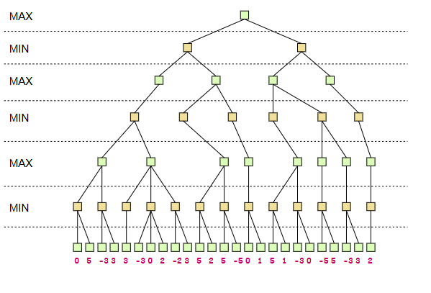

Slide 61
Alpha-Beta Pruning
Minimax is computationally expensive
Advance version of min max.
Solution:
Prune branches that won’t affect decisions.
Key Concepts:
Alpha (maximizer's guarantee) and Beta (minimizer's guarantee).
Result:
Improved efficiency.
Notes:
Alpha-beta pruning is an optimization technique for the minimax algorithm used in artificial intelligence for two-player games (adversarial search). It significantly reduces the number of nodes evaluated in the game tree by eliminating branches that cannot possibly influence the final decision, without affecting the optimal result.
How it Works
The algorithm uses a depth-first search approach and maintains two threshold values, alpha and beta, to determine when a branch can be "pruned" (cut off):
Alpha: The best (highest) value that the maximizing player can guarantee for themselves so far at any point along the path to the root. It is initialized to negative infinity.
Beta : The best (lowest) value that the minimizing player can guarantee for themselves so far at any point along the path to the root. It is initialized to positive infinity.
The core condition for pruning is when alpha >=beta. At this point, the algorithm stops evaluating the current branch because it is guaranteed that the optimal player (either maximizer or minimizer) will choose a better path found earlier in the tree.
Efficiency: By pruning unnecessary branches, it drastically speeds up the search process compared to the standard minimax, allowing AI to search deeper into the game tree within the same time constraints.
Optimality: The crucial advantage of alpha-beta pruning is that it still returns the same optimal move as the full minimax search.
Move Ordering: The effectiveness of the pruning is highly dependent on the order in which moves are evaluated. If the best moves are examined first, more branches can be pruned early, maximizing efficiency.

Slide 62
Example
MAX
MIN
MAX
5
3
8
2
-5
-2
2
4
-1
Notes:
If alpha >= beta prune

Slide 63
Real-World Applications
Gaming AI:
Deep Blue (Chess), AlphaGo (Go).
Decision-Making Systems:
Autonomous vehicles, market strategies.
Notes:
Main Areas of Application of Alpha-Beta Pruning:
🎮 1. Game Playing (AI for Two-Player Games)
Alpha-beta pruning is most commonly used in games that are modeled as adversarial search problems:
Chess
Checkers
Tic-Tac-Toe
Go
Othello (Reversi)
Connect Four
Shogi
Backgammon
👉 These games use minimax search trees, where alpha-beta pruning helps reduce computation time.
🤖 2. Artificial Intelligence and Machine Learning (Adversarial Agents)
Used in AI agents where opponent modeling is required:
Strategic simulations
AI bots for board or card games
Adversarial learning environments (e.g., reinforcement learning with multiple agents)
🛡️ 3. Decision-Making Systems with Competing Objectives
Any system where decisions are made in an adversarial or competitive setting can use alpha-beta pruning:
Economic simulations involving negotiation
Security systems simulating attacker-defender scenarios
Cybersecurity games (defense vs attacker)
🧠 4. Robot Motion Planning in Adversarial Settings
In multi-robot systems where one robot tries to block or intercept another:
Alpha-beta can reduce unnecessary path exploration
Used in AI planning with adversarial obstacles
📊 5. Game Theory and Strategic Planning
In theoretical or computational models of zero-sum games:
Business or military strategies
Resource allocation under adversarial conditions
🚀 Summary:
Area Example Use Case
Game AI Chess engine move decision
Competitive AI agents Reinforcement learning in adversarial games
Security planning Intrusion detection simulations
Robot planning Movement planning in adversarial environments
Game theory simulations Strategic modeling of zero-sum games
Example: Chess
🔍 The Problem
Chess is a two-player zero-sum game, where one player's gain is the other's loss. The goal of a chess AI is to decide the best move by evaluating all possible moves, then all possible opponent responses, and so on. This creates a huge search tree of possible game states.
🧠 Without Alpha-Beta Pruning: Minimax
Minimax explores the entire tree up to a certain depth:
Max node (AI’s move): Selects the maximum score move.
Min node (Opponent’s move): Selects the minimum score move.
But the number of game states increases exponentially:
If each player has ~35 legal moves and you look 5 moves ahead: That's about 35^5 = 52,521,875 game states! 😵
⚡ With Alpha-Beta Pruning: Efficiency
Alpha-beta pruning cuts off branches that cannot possibly influence the final decision, thus avoiding evaluating unnecessary nodes.
Alpha (α): Best value that the maximizer (AI) can guarantee so far.
Beta (β): Best value that the minimizer (opponent) can guarantee so far.
If at any point β ≤ α, the algorithm prunes (doesn’t explore) that branch.
✅ Benefit in Chess AI
Reduces time complexity from O(b^d) to O(b^(d/2)) in best case
b = branching factor (avg moves)
d = depth
Allows AI to search deeper in the same amount of time
Enables real-time decision-making

Slide 64

Constraint Satisfaction Problem (CSP)
Problem where the solution must satisfy a set of constraints
Variables, Domains, Constraints
Examples: Sudoku, Scheduling, Resource allocation, Planning
Notes:
Notes:
In a Constraint Satisfaction Problem (CSP), you need to find a solution that satisfies a set of constraints (rules that must not be violated).
Components:
Variables: Elements you are trying to assign values to (e.g., in Sudoku, the cells).
Domains: Possible values each variable can take.
Constraints: Rules that restrict how variables can be assigned (e.g., in Sudoku, numbers cannot repeat in a row, column, or grid).
Example: Sudoku is a typical CSP—each cell must contain a number between 1 and 9, and there are constraints on the placement of numbers.

Slide 65
Types of CSPs
Binary CSP
Non-binary CSPs
Hard and Soft CSPs
Notes:
Binary CSP>>> each constraint involves only two variables. For example, in a scheduling problem, the constraint could specify that task A must be completed before task B.
Non Binary >> have constraints that involve more than two variables. For instance, in a seating arrangement problem, a constraint could state that three people cannot sit next to each other
Hard and Soft Constraints: Hard constraints must be strictly satisfied, while soft constraints can be violated, but at a certain cost. This distinction is often used in real-world applications where not all constraints are equally important.

Slide 66
Search Algorithms for CSP
Algorithms:
Backtracking Search: Simple and direct approach but can be slow.
Constraint Propagation: Pre-processes the problem to reduce complexity, improving efficiency.
Notes:
Search Algorithms for CSPs
Overview: Explores techniques to find solutions for CSPs.
Algorithms:
Backtracking Search: Simple and direct approach but can be slow.
Constraint Propagation: Pre-processes the problem to reduce complexity, improving efficiency.
Backtracking Search
Details:
The algorithm incrementally assigns values to variables and checks constraints at each step.
If constraints are violated, it backtracks to try different values.
Steps:
Start with the first variable.
Assign a value from its domain.
Move to the next variable.
Backtrack if no value satisfies the constraints.
Challenges: Can lead to combinatorial explosion in larger problems.
Optimizations: Use heuristics like minimum remaining values (MRV) to choose variables more intelligently.
Slide 9: Constraint Propagation
Details: Improves search by enforcing constraints during the search process.
Techniques:
Arc Consistency:
If a variable’s domain value conflicts with all values of a connected variable, it’s removed from the domain.
Forward Checking:
When a variable is assigned, incompatible values are removed from the domains of future variables.
Example:
In map coloring, if one region is assigned "Red," adjacent regions cannot have "Red," reducing their domains.
Advantages:
Speeds up search by pruning invalid paths early.

Slide 67
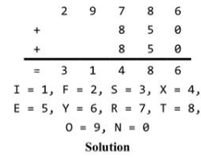

Crypt- arithmatic problems

Slide 68
Production System
Water jug problem

Slide 69
Questions
What is state space search? Give example of a game that happens to be a problem of state space search and justify answer.
What are components of problem formulation? Formulize 8-queen problem.
Solve the following CSP 7 + 8 = 12,

